Slide 1
Academic Reading & Writing
Unit 5: Home/School Communications of Recent Immigrants
Results & Discussion Sections

Slide 2
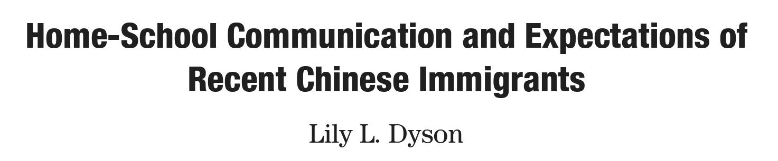
This Week’s Reading
Last week we read through the first two sections
This week we will focus on Results and Discussion sections using this paper

Slide 3

Unit 5 – Reading Quiz
We will have our usual quiz on reading content and vocabulary
Some questions may have more than one answer - you must select all correct answers to receive full marks
The link will be posted to the WeChat group
You have 20 minutes

Slide 4
Final Assignment

Slide 5
Final Assignment
Now that we have covered all the major paper sections (Introduction, Methods, Results, Discussion), we know the framework for most research papers
The final assignment for this class will be to write a practice IMRD research paper
We will provide some information about the methods and a set of raw data for you to use – you will have a choice of quantitative or qualitative data sets

Slide 6
Final Assignment Details
Using the material given and some background research of your own (more than 5 sources), write a practice research paper using the basic IMRD format (no variants this time)
Use standard APA format (citations and layout, should look like papers in the textbook), 12-point standard font, headings, and no more than 12 pages (focus on content, not word count)
This will be due on the last day of class

Slide 7
Results Sections
Purpose and Function

Slide 8
Results
The Results section is intended to present and illustrate your findings, answering the question what – what did you find?
The most important thing to remember about this section is to be objective – you do not want to add any interpretation or personal responses, only findings
You can use graphs and tables if the data is suitable, but you should include a summary of the main findings in the text
This is not just a summary of all the raw data – focus on relevant details

Slide 9
Integrating Tables and Figures
Figures here refer to any charts, images, or illustrations necessary for conveying data
Tables and figures should be clearly labelled in order (i.e. Figure 1, Figure 2, Table 1, Table 2)
Figures are labelled using captions that go underneath the figure
Tables are titled using a heading (which may have a description) that goes above the table
This is true for other sections as well

Slide 10
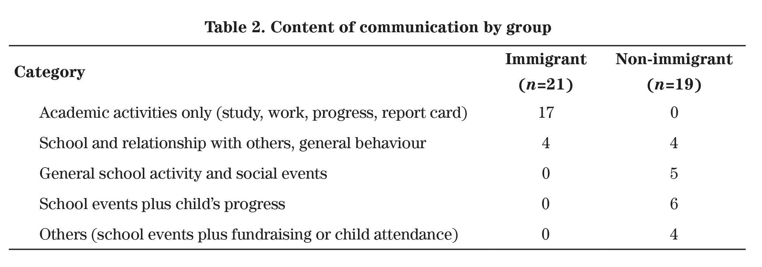
Example Table from the Reading (p.152)
Description
Labelled Title

Slide 11
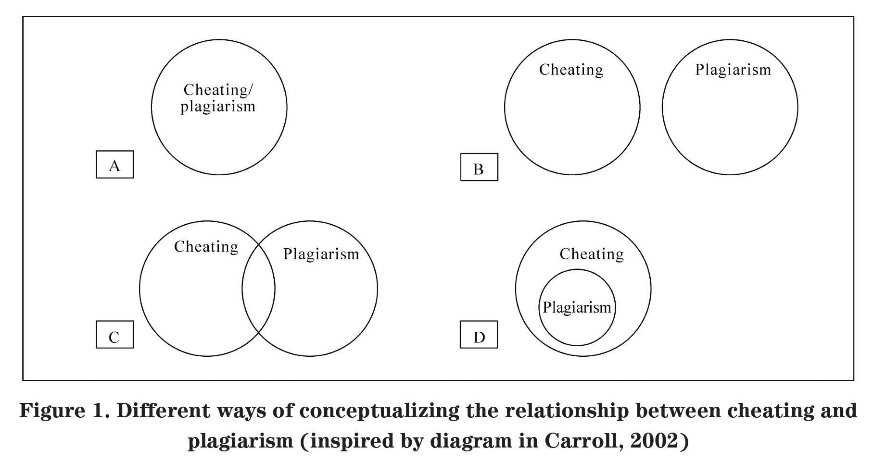
Example Figure from Unit 2 Reading (p.40)
Labelled Caption
Description

Slide 12
Table/Figure location
Tables and figures should be integrated into the text of the Results section or after the bibliography/references section – you cannot do both
If you choose to place them all at the end, make sure they are clearly distinguished from any appendices (so they’re not confused with raw data tables, interview transcripts, etc.)
Each table and figure should be complete enough that you could remove it from the text and it could work on its own (should be well labelled, should not depend on the text to be understood – table supports the text, not the other way around)

Slide 13
Results Contents (p.167)
Summarize your findings (if appropriate or necessary, use tables and figures to illustrate)
In the text, describe each of your results and point the reader to the most relevant observations
Provide a context, such as by describing the question that was addressed by making a particular observation
Describe the results of control experiments and describe results that are not included in a table or figure, if appropriate

Slide 14
Five themes emerged that corresponded to the research questions from the analysis of the coded data: (a) pattern of communication, (b) understanding of communication, (c) satisfaction with communication,(d) understanding of school’s valuing of child’s culture, (e) knowledge of the school’s multicultural education.
What is this paragraph (from the beginning of the Results section) doing?
Which of the four types of content does this match with best?
Page 150

Slide 15
Pattern of communication Method of communication. Table 1 also shows the various methods parents employed to communicate with their children’s school. Both groups of parents used in-person communication most often. [….] However, unlike non-immigrant parents, immigrant parents did not use the telephone alone as a method for communicating with schools. When asked about the best means for the school to communicate with them, one third of the Chinese parents did not show any preference.
What is this paragraph (from the beginning of the Results section) doing?
Which of the four types of content does this match with?
Page 150

Slide 16
Collocation Exercise – Use these word to fill in the sentences on Page 165
Distributed | Total | Corroborate | Employed
Randomly | The Recruitment Letters | Combined | Discrepencies
Provides | Representation | Dramatic | Communication
Methods | Increase | Adjusted | Selected
Broad | Previous Research | Prompt | Summary

Slide 17
Distributed | Total | Corroborate | Employed
Randomly | The Recruitment Letters | Combined | Discrepencies
Provides | Representation | Dramatic | Communication
Methods | Increase | Adjusted | Selected
Broad | Previous Research | Prompt | Summary
I ＿＿＿＿＿＿ ＿＿＿＿＿to potentially eligible Chinese families through these recruitment sources.
These families had a __________ ______________of 46 children, 21 Chinese and 25 European Canadian.
Such a study would be particularly timely because of the ＿＿＿＿ ＿＿＿＿＿＿ in recent years of Chinese immigration to Canada.
From this variety of sources, I obtained a ____________ _______________ of both the Chinese and Caucasian families in the city.
I _________ ______________before I finalized the Chinese version.

Slide 18
Distributed | Total | Corroborate | Employed
Randomly | The Recruitment Letters | Combined | Discrepencies
Provides | Representation | Dramatic | Communication
Methods | Increase | Adjusted | Selected
Broad | Previous Research | Prompt | Summary
6) We identified a small, _________ ___________ sample of the participants and analyzed their responses.
7) Table 1 shows the various __________ parents __________ to communicate with their children’s schools.
8) The following quotation from a participant ＿＿＿＿＿＿ ＿＿＿＿＿＿ of these criticisms.
9) These results __________ ____________ that was conducted in structured laboratory contexts.
10) The study established several expectations for online learners, including regular and __________ __________ with professors and clear expectations of the professors.

Slide 19
Discussion
Function & Style

Slide 20
Discussion Function
While Results must be objective and fact-based, Discussion is where you interpret the data for your reader
Here you want to use your results to support your conclusions – instead of saying what, you want to answer so what?
How does this help answer your research question?
Does this confirm/deny your hypothesis?
Does the method you chose work?

Slide 21
Discussion Content
Use evidence from your results and generally accepted knowledge to support your conclusion (can bring in other sources as well)
Explain the significance of your findings
Interpret your data – explain mechanisms that could have produced the results
You never want to state a conclusion or that results were (un)expected without discussing why it is
If hypothesis is not supported, try to explain what might have happened
If hypothesis supported, try to explain the theory behind why the results agreed

Slide 22
Results vs Discussion
Results deal with facts and outcomes, summarizing what happened as a result of the study
Discussion deal with points and interpretation, and should go beyond summaries and results into explanations and educated speculation

Slide 23
Style
We can think about organizing the Discussion as a series of moves containing points, most of which we’ve seen:
Move 1 | Points to consolidate your research space, main discussion of results (mandatory)
Move 2 | Points to indicate the limitations of your study (common and recommended)
Move 3 | Points to identify useful areas of further research (Optional)

Slide 24
Style
Move 1 | Summarize results Supporting previous findings Contradicting previous findings Indicating unexpected outcomes Offering an explanation for the findings | The results of the study show/indicate that… This finding is consistent with Smith (2000) who… The outcome was contrary to that found in Smith (2000) where… One unanticipated finding was… This discrepancy is possibly due to …

Slide 25
Practice – Task 2 (Page 169)
We will read a draft Discussion section.
After reading, try to find the three Discussion moves
Consider the linguistic characteristics of each move, such as:
Verb tenses
Voice

Slide 26
Discussion
The small sample sizes in these studies require great caution in drawing conclusions. However, several patterns were apparent in the results and these deserve some comment. At the very least, these studies offer two case-study views of the ways some students cope with studying in L2. We offer the following interpretations as speculations in need of further confirmation. Our comments concern what the students say they are doing during study and summarization, and what effect these processes have on performance.
Page 169

Slide 27
In spite of their varying language difficulties, both groups of subjects employed deep processing. Both groups used more surface processing, with the more fluent subjects doing more appropriate surface processing. This supports the argument made earlier in this paper that a reasonable level of fluency provides a basis for higher level processes.
Page 169

Slide 28
The results are not consistent with the suggestions of some (e.g. Kozminsky and Graetz, 1996) that L2 students are forced to rely solely upon surface processing, nor with those of others who conclude that L2 students tend to use deep processing as a “top-down” way of coping with ambiguous detail (e.g. Canwell and Biggs, 1988). Rather these results suggest that interlingua transfer and application of deep processing strategies is not automatic.
Page 169

Slide 29
We wish to suggest two general ways in which educators can facilitate their L2 students’ learning. These suggestions derive largely from the literature, but are consistent with the results of these two studies. First, strategies that compensate for lack of fluency, reducing the cognitive load for L2 students and thereby freeing up their resources for higher-order activities, will be of value. The second approach is to ensure that students use their available processing capacity as effectively as possible.
Page 170

Slide 30
Questions
What are the three moves?
What are the linguistic characteristics of each?
Move 1 | Points to consolidate your research space, main discussion of results (mandatory)
Move 2 | Points to indicate the limitations of your study (common and recommended)
Move 3 | Points to identify useful areas of further research (Optional)

Slide 31
We’ll look at some quotes from this week’s reading and try to match them with one of our three moves. They are not all in order.
Move 1 | Points to consolidate your research space, main discussion of results (mandatory)
Move 2 | Points to indicate the limitations of your study (common and recommended)
Move 3 | Points to identify useful areas of further research (Optional)

Slide 32
In this study, I examined the home-school communication of Chinese families who recently immigrated to Canada. As expected, even in the absence of socio-economic difficulties, cultural and linguistic uniqueness created a largely distinct pattern of parental communication with schools. Thus, in comparison with non-immigrants, immigrant parents communicated with schools less often, had more difficulty understanding the communication, and were less satisfied with the school’s communication style and multicultural education program. However, immigrant parents also circumvented the language barrier by using an interpreter (e.g., their own children, friends, or school appointee) to facilitate their communication with schools.
Page 158

Slide 33
The Chinese parents’ response to the issue of multicultural education further reflected ineffective home-school communication. Many Chinese parents were dissatisfied because the school did not value their race and culture; others were unaware of multicultural education at school. There were also Chinese parents who did not consider the multicultural education practised in schools adequate, especially to fulfil their desire to integrate their children into the mainstream Canadian life while preserving their ethnic distinction. The Chinese parents requested a multicultural education program that not only valued their ethnicity and culture but also contained substance that went beyond occasional, ceremonial festivals. Such a program would involve the ample inclusion of Chinese or Asian culture and history in the regular curriculum and the daily practice of multicultural education at school. However, Chinese parents’ dissatisfaction may have been caused by their lack of knowledge about the school’s existing multicultural education.
Page 158/159

Slide 34
The present study has produced a preliminary set of interview data and new knowledge about home-school communication of recent immigrants such as Chinese. The results suggest other immediate research questions such as: (a) are these findings replicable in other urban centres and with other cultural minorities? and (b) what practices have been shown successful to improve home-school communication?
Page 160

Slide 35
The results of this study corroborate previous research indicating that language differences may hinder immigrant families’ effective communication and involvement with schools (Commins, 1992; Constantino et al., 1995; Gougeon, 1993). The results further highlight the impact of the language barrier and cultural differences on recently immigrated parents’ communication with and expectations of their children’s schools. Of interest, the discontent of immigrant parents with the school’s curriculum and instruction alludes to the difference between Chinese parents and Canadian schools in pedagogical philosophy. The dissatisfaction also suggests that, perhaps for lack of adequate communication, immigrant parents fail to understand the school’s philosophy.
Page 159

Slide 36
The inclusion of families mainly with socio-economic advantages delimits the results of this study. Parents with less economic resources may have different experiences in communicating with the school and should be included in future studies. Research may further involve teachers and children as informants to study the bi-directional process that characterizes home-school communication (Theilheimer, 2001). Future research may also consider the pedagogical orientation of schools and immigrant parents as a factor mediating the communication between home and school.
Page 160
Notes:
Could be Move 2 and move 3

Slide 37
Practice Task 3 (Page 170)
There are six sentences in the book.
Try to decide based on what we have covered today which section they belong to, Results or Discussion?

Slide 38
Degree of misclassification for self-reported current smokers was minor (0–3%), regardless of cotinine cut-point used.
Second, the present study’s use of nocturnal pancreatic emissions may not have been appropriate.
Their answers and comments show a very high degree of satisfaction, as reflected in the two bar charts below.
To test the hypothesis that hepatic secretions would be associated with self reports of small furry animal phobia, a series of correlations between Bile Production and scores on the ABIT self report were computed.
This unexpected result can be interpreted in several ways.
Future research should direct attention to both psychological and biological factors that influence small furry animal phobia.

Slide 39
Results/Discussion Variants
We will read a few excerpts from a supplementary reading (127-137)

Slide 40
Questions
Then we want to think about the following:
How did this paper structure its results and discussion? How is it different from the standard?
What tools did this paper use to share its results?
Does this paper’s discussion show the three moves we’ve seen?

Slide 41
Data analysis results
Table 2 gives the results of the error collection and categorization. It is rather striking that such a tiny fraction of words were looked up in a dictionary, only 674 (1.6%) of the total corpus of 41,024 words. Yet, more striking is the fact that of those 674 dictionary words, 283 (42%) were used incorrectly. These results are discussed in more detail below.
Page 127

Slide 42
Interview results
The purpose of the interviews was to identify the dictionary strategies used by learners and then to try to determine why some of the students and strategies appeared to be successful although others did not. The students chosen to be interviewed were all paid minimum student-worker wage. Each interview (one session per student) lasted from 45 to 120 min. Space does not allow for a detailed analysis of all of the interviews, but the most salient parts of each will be discussed here.
Page 127

Slide 43
General discussion
At first glance, the tiny fraction of words in the corpus that were looked up in a dictionary, 1.6% (see Table 2), raises the question of whether or not this study of dictionary use is necessary or even worthwhile. The dictionary words identified here are obviously not a major part of the overall process of these students’ FL writing production.
Page 133

Slide 44
Nevertheless, dictionaries are basic tools for FL learners. Moreover, even if dictionaries are not used as much as might be expected for some tasks, such as timed in-class writing, they are used by most students. Only two students out of the 53 who contributed writings to this study never used any dictionary (their data was not included in Table 2). It is extremely important to remember that in the minds of many FL learners, their dictionaries are repositories of “all truth and guidance” (Abraham et al., 1994, p. 9), and at least at the beginner level a learner’s first impulse is often to turn to a dictionary.
Page 133

Slide 45
Furthermore, the errors analyzed are important, if for no other reason, because they were made despite dictionary use. Why use a dictionary at all if not to ensure that what you are writing is correct? From this perspective, the 42% error rate represents a dramatic failure.
Page 133

Slide 46
Questions
How did this paper structure its results and discussion? How is it different from the standard?
Are the in-between sections (Interviews 127-133) more Results or more Discussion?
What tools did this paper use to share its results?

Slide 47
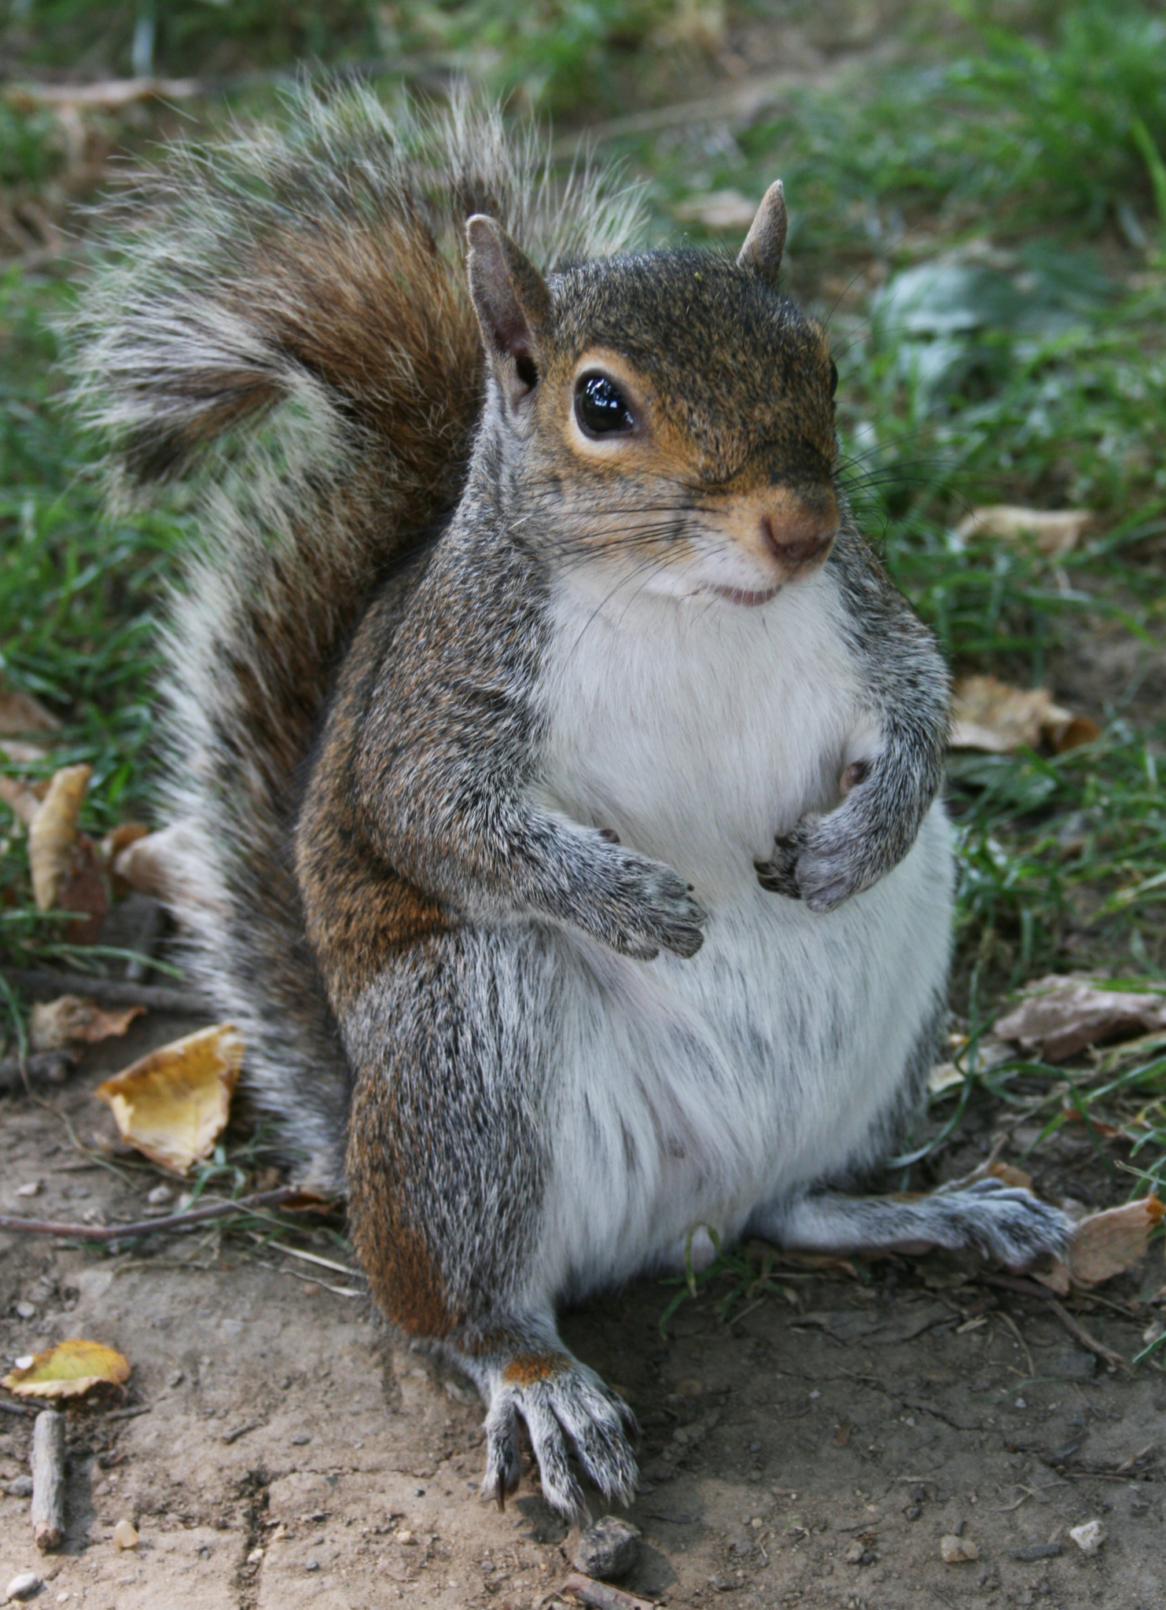
Practice - Results
In the document online, you will find some data on a very simple experiment
Use the figures and information to write a short Results section
Remember: you should not be writing any details on any of the other sections – only Results
You may make up extra figure and tables if you like, but don’t just include the raw data tables – highlight key information

Slide 48

Next Week
We will start a new unit.
No Quiz next week.

